Slide 1
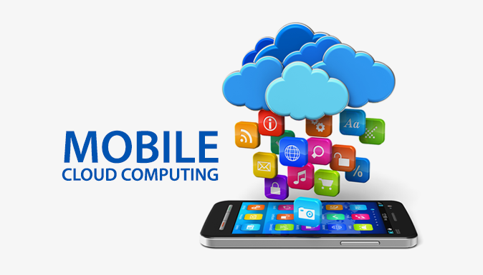
U20ITCM02S – Mobile computing III Year / V Semester

Slide 2
Course Outcomes
CO1 - Explain the basics of mobile telecommunication system(K2)
CO2 - Articulate the required functionality at each layer for given application(K2)
CO3 - Identify solution for all functionality at each layer. (K1)
CO4 - Use simulator tools and design Ad hoc networks(K3)
CO5 - Develop a mobile application(K6)

Slide 3
Syllabus
UNIT I INTRODUCTION
Mobile Computing – Mobile Computing VsWireless Networking – Mobile Computing Applications – Characteristics of Mobile computing – Structure of Mobile Computing Application. MAC Protocols – Wireless MAC Issues – Fixed Assignment Schemes – Random Assignment Schemes – Reservation Based Schemes.
UNIT II MOBILE INTERNET PROTOCOL AND TRANSPORT LAYER
Overview of Mobile IP – Features of Mobile IP – Key Mechanism in Mobile IP – route Optimization. Mobile TCP– WAP – Architecture – WDP – WTLS – WTP –WSP – WAE – WTA Architecture – WML
UNIT III MOBILE TELECOMMUNICATION SYSTEM
Global System for Mobile Communication (GSM) – Services & Architecture- Protocol-Connection Establishment – General Packet Radio Service (GPRS) – Universal Mobile Telecommunication System (UMTS) – Handover - Security.
UNIT IVMOBILE AD-HOC NETWORKS
Ad-Hoc Basic Concepts – Characteristics – Applications – Design Issues – Routing Popular Routing Protocols– Vehicular Ad Hoc networks (VANET) – MANET Vs VANET – Security.
UNIT V MOBILE PLATFORMS AND APPLICATIONS
Mobile Device Operating Systems – Special Constrains & Requirements – Commercial Mobile Operating Systems – Software Development Kit: iOS, Android, BlackBerry, Windows Phone – M- Commerce – Structure – Pros & Cons – Mobile Payment System – Security Issues.

Slide 4
Textbooks & References
Text Books
Prasant Kumar Pattnaik, Rajib Mall, “Fundamentals of Mobile Computing”, PHI Learning Pvt. Ltd, New Delhi – 2012.
Jochen H. Schller, “Mobile Communications”, Second Edition, Pearson Education, New Delhi, 2007
C.K.Toh, “AdHoc Mobile Wireless Networks”, First Edition, Pearson Education, 2002.
Reference Books
Dharma Prakash Agarval, Qing and An Zeng, “Introduction to Wireless and Mobile systems”, Thomson Asia Pvt Ltd, 2005.
William.C.Y.Lee,“Mobile Cellular Telecommunications-Analog and Digital Systems”, Second Edition,TataMcGraw Hill Edition ,2006.
UweHansmann, LotharMerk, Martin S. Nicklons and Thomas Stober, “Principles of Mobile Computing”, Springer, 2003.
Web References
Developers : http://developer.android.com/index.html
Apple Developer : https://developer.apple.com/
Windows Phone DevCenter: http://developer.windowsphone.com 9. BlackBerry Developer : http://developer.blackberry.com/

Slide 5
UNIT - III
Mobile TeleCommunication System

Slide 6
DISCUSSION TOPICS
Global System for Mobile Communication (GSM)
Services & Architecture
Protocol
Connection Establishment
General Packet Radio Service (GPRS)
Universal Mobile Telecommunication System (UMTS)
Handover
Security

Slide 7
GSM – GLOBAL SYSTEM FOR MOBILE COMMUNICATION

Slide 8
What is GSM?
GSM stands for Global System for Mobile Communication. It is a digital cellular technology used for transmitting mobile voice and data services.
The Global System for Mobile Communications (GSM) is a standard developed by the European Telecommunications Standards Institute (ETSI) to describe the protocols for second-generation (2G) digital cellular networks used by mobile devices such as mobile phones and tablets. 2G networks developed as a replacement for first generation (1G) analog cellular networks
GSM is the most successful digital mobile telecommunication system in the world today. It is used by over 800 million people in more than 190 countries.

Slide 9
HISTORY
The concept of GSM emerged from a cell-based mobile radio system at Bell Laboratories in the early 1970s.
GSM is the name of a standardization group established in 1982 to create a common European mobile telephone standard.
GSM is a circuit-switched system that divides each 200 kHz channel into eight 25 kHz time-slots.

Slide 10
HISTORY
GSM operates on the mobile communication bands 900 MHz and 1800 MHz in most parts of the world. In the US, GSM operates in the bands 850 MHz and 1900 MHz.
GSM was developed using digital technology. It has an ability to carry 64 kbps to 120 Mbps of data rates.

Slide 11
IMPORTANT FACTS ABOUT GSM
GSM is the most widely accepted standard in telecommunications and it is implemented globally.
GSM owns a market share of more than 70 percent of the world's digital cellular subscribers.
GSM makes use of narrowband Time Division Multiple Access (TDMA) technique for transmitting signals.
GSM provides basic to advanced voice and data services including roaming service. Roaming is the ability to use your GSM phone number in another GSM network.

Slide 12
GSM FEATURES
GSM criteria –
Good subjective speech quality
Low terminal and service cost
Support for international roaming – one system for all of Europe
Ability to support handheld terminals
Support for range of new services and facilities
Enhanced Features
ISDN( Integrated Services Digital Network )compatibility
Enhance privacy
Security against fraud

Slide 13
GSM SERVICES
GSM offers three basic types of services −
Data services or bearer services
Telephony services or teleservices
Supplementary services

Slide 14
BEARER SERVICES
Data services or Bearer Services are used through a GSM phone. It supports SMS, E-mail, voice mail, and internet access and execute remote application
to receive and send data is the essential building block leading to widespread mobile Internet access and mobile data transfer.
GSM currently has a data transfer rate of 9.6k. New developments that will push up data transfer rates for GSM users are HSCSD (high speed circuit switched data) and GPRS (general packet radio service) are now available..

Slide 15
Teleservices
The abilities of a Bearer Service are used by a teleservice to transport data. These services are further transited in the following ways:
Voice Calls
The most basic Teleservice supported by GSM is telephony. This includes full-rate speech at 13 kbps
Emergency calls
where the nearest emergency-service provider is notified by dialing three digits.

Slide 16
Short Text Messages
SMS service is a text messaging service that allows sending and receiving text messages on your GSM mobile phone.
In addition to simple text messages, other text data including news, sports, financial, language, and location-based data can also be transmitted.
Facsimile or Fax: Using modem fax data is transmitted as digital data over the analog telephone network.

Slide 17
Supplementary services
Supplementary services are additional services that are provided in addition to teleservices and bearer services.
These services include caller identification, call forwarding, call waiting, multi-party conversations, and barring of outgoing (international) calls

Slide 18
System Architecture of GSM
The three main subsystems are
Radio Subsystem (RSS)
Networking and switching subsystem(NSS)
Operation Subsystem (OSS)

Slide 19
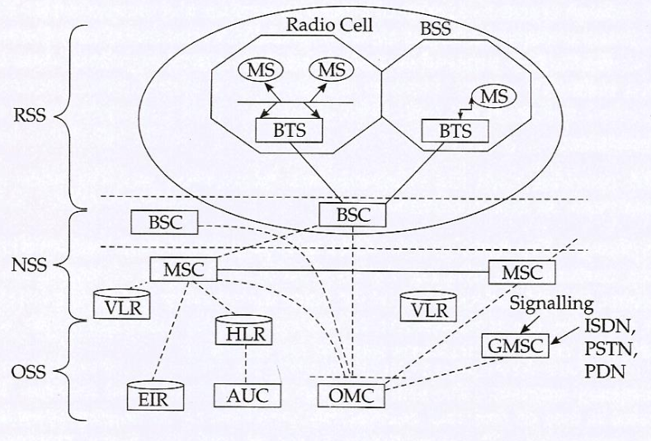
Functional architecture of a GSM system

Slide 20
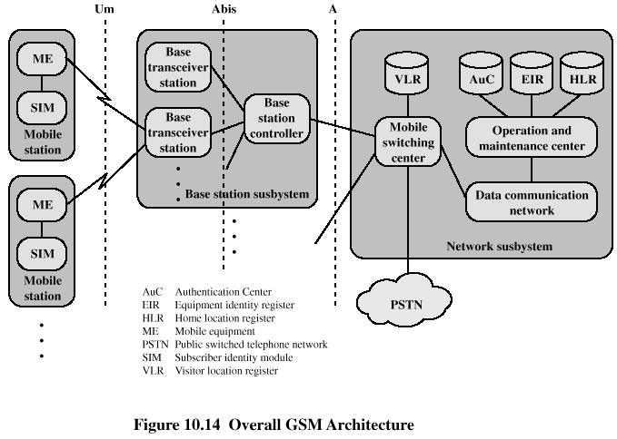
GSM Network Architecture

Slide 21
System Architecture
Mobile Station (MS)
Mobile Equipment (ME)
Subscriber Identity Module (SIM)
Base Station Subsystem (BBS)
Base Transceiver Station (BTS)
Base Station Controller (BSC)
Network Subsystem
Mobile Switching Center (MSC)
Home Location Register (HLR)
Visitor Location Register (VLR)
Authentication Center (AUC)
Equipment Identity Register (EIR)

Slide 22
Radio Subsystem (RSS)
This subsystem comprises all the radio specific entities.
Mobile Station (MS)
The Mobile Station is made up of two entities:
Mobile Equipment (ME)
Subscriber Identity Module (SIM)

Slide 23
Mobile Equipment
Produced by many different manufacturers
Must obtain approval from the standardization body
Uniquely identified by an IMEI (International Mobile Equipment Identity)

Slide 24
Subscriber Identity Module (SIM)
Smart card containing the International Mobile Subscriber Identity (IMSI)
Allows user to send and receive calls and receive other subscribed services
Encoded network identification details
Protected by a password or PIN
Can be moved from phone to phone – contains key information to activate the phone

Slide 25
Base Station Subsystem (BSS)
Base Station Subsystem is composed of two parts that communicate across the standardized Abis interface allowing operation between components made by different suppliers
Base Transceiver Station (BTS)
Base Station Controller (BSC)

Slide 26
Base Transceiver Station (BTS)
A BTS comprises all radio equipment such as antenna, signal processors and amplifiers that are necessary for radio transmission.
It encodes the received signal, modulates it on a carrier wave and feeds the RF signals to the antenna.
It communicates with both the mobile station and the BSC

Slide 27
Base Station Controller (BSC)
Manages Resources for BTS
It assigns frequency and time slot for and MS for call set up
It manages the handoff from one BTS to another within the BSS.
BSC multiplexes the radio channel onto the fixed network connection to the Mobile Switching Centre.

Slide 28
Network and Switching Subsystem(NSS)
It is the heart of the GSM system. It connects the wireless networks to the standard public networks. It carries out usage based charging, accounting and also handles roaming.
Mobile Switching Center (MSC)
Heart of the network
Switch speech and data connections between:
Base Station Controllers
Mobile Switching Centers
GSM-networks
Other external networks
Three main jobs:
1) connects calls from sender to receiver
2) collects details of the calls made and received
3) supervises operation of the rest of the network components

Slide 29
Home Location Registers (HLR)
- contains administrative information of each subscriber
- IMSI and current location of the mobile
Visitor Location Registers (VLR)
- A temporary database that is updated whenever a new MS enters its area by reaming.
- contains selected administrative information from the HLR
authenticates the user
tracks which customers have the phone on and ready to receive a call
periodically updates the database on which phones are turned on and ready to receive calls

Slide 30
Operation subsystem (OSS)
The operation subsystem contains all the function necessary for network operation and maintenance.
Authentication Center (AUC)
mainly used for security
data storage location and functional part of the network
Ki is the primary element
Equipment Identity Register (EIR)
- Database that is used to track handsets using the IMEI (International Mobile Equipment Identity)
Made up of three sub-classes: The White List, The Black List and the Gray List
Optional database

Slide 31
GSM Security
Security in GSM is broadly supported at three levels: Operator level, Customer's level and System level. These three levels help oversee aspects such as correct billing, avoiding fraud, protecting services and ensuring anonymity.
Authentication
Protect the network against unauthorized use.
Denying the possibility for intruders to impersonate authorized users.
GSM network operator verify the identity , making it highly improbable to clone someone's mobile phone identity.
Authentication can be achiced in a simple way by using a password such as PIN.

Slide 32
Confidentiality
GSM network protects voice, data and sensitive information against eavesdropping on the radio path.
It is achieved by using encryption techniques by GSM designers.
Data on the radio path is encrypted between the ME and BTS against eavesdropping.
Anonymity
GSM protects against someone tracking the location of a user or identifying calls made to the user by eavesdropping on the radio path.
It is achieved by allocating Temporary Mobile Subscriber Identity (TMSIs) instead of permanent indentities.

Slide 33
Advantages of GSM
Crisper, cleaner quieter calls
Security against fraud and eavesdropping
International roaming capability in over 100 countries
Improved battery life
Efficient network design for less expensive system expansion
Efficient use of spectrum
Advanced features such as short messaging and caller ID
A wide variety of handsets and accessories
High stability mobile fax and data at up to 9600 baud
Ease of use with over the air activation, and all account information is held in a smart card which can be moved from handset to handset

Slide 34
General Packet Radio Service ( GPRS)

Slide 35
GPRS when integrated with GSM significantly improves and simplifies Internet access.
GPRS is a packet oriented mobile data service on the 2G and 3G cellular communication system's global system for mobile communications (GSM).
GPRS was originally standardized by European Telecommunications Standards Institute (ETSI) in response to the earlier CDPD and i-mode packet-switched cellular technologies.
It is now maintained by the 3rd Generation Partnership Project (3GPP).
GPRS usage is typically charged based on volume of data transferred, contrasting with circuit switched data, which is usually billed per minute of connection time.

Slide 36
GPRS Services
GPRS offers end-to-end packet-switched data transfer services which can be categorized
Point-to-point (PTP) services
Point-to-Multipoint (PTM) services
Point-to-point (PTP) service is between tow users and can either be connectionless ofr connection-oriented.
Point-to-Multipoint (PTM) services is data transfer from one user to multiple users. The two types of PTM services.
I. One is multicast PTM where the data packets are broadcast
in a certain area and
II. The other is group PTM where the data packets are addressed to a group of users

Slide 37
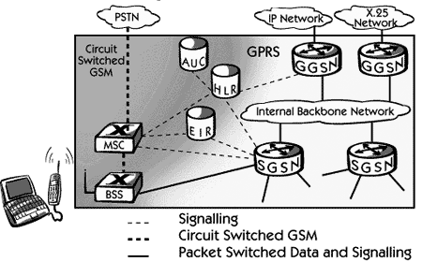
GPRS Architecture

Slide 38
GSM Network Element | Modification or Upgrade Required for GPRS.
Mobile Station (MS) | New Mobile Station is required to access GPRS services. These new terminals will be backward compatible with GSM for voice calls.
BTS | A software upgrade is required in the existing base transceiver site.
BSC | The base station controller (BSC) requires a software upgrade and the installation of new hardware called the packet control unit (PCU). The PCU directs the data traffic to the GPRS network and can be a separate hardware element associated with the BSC.
GPRS Support Nodes (GSNs) | The deployment of GPRS requires the installation of new core network elements called the serving GPRS support node (SGSN) and gateway GPRS support node (GGSN).
Databases (HLR, VLR, etc.) | All the databases involved in the network will require software upgrades to handle the new call models and functions introduced by GPRS.

Slide 39
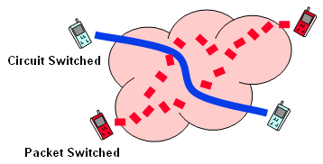

Slide 40
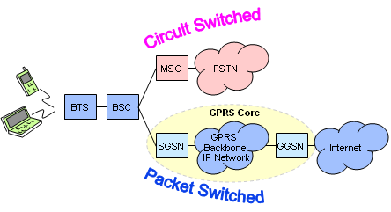

Slide 41
UMTS
The Universal Mobile Telecommunications System (UMTS) is a third generation mobile cellular system for networks based on the GSM standard. ..
UMTS (Universal Mobile Telecommunications Service) is a third-generation (3G) broadband, packet-based transmission of text, digitized voice, video, and multimedia at data rates up to 2 megabits per second (Mbps).
UMTS offers a consistent set of services to mobile computer and phone users, no matter where they are located in the world. Based on the Global System for Mobile (GSM) communication standard, UMTS is endorsed by major standards bodies and manufacturers and is the planned standard for mobile users around the world.

Slide 42
Universal Mobile Telephone System (UMTS)
Reasons for innovations
new service requirements
availability of new radio bands
User demands
seamless Internet-Intranet access
wide range of available services
compact, lightweight and affordable terminals
simple terminal operation
open, understandable pricing structures for the whole spectrum of available services

Slide 43
The UMTS was developed mainly for countries with GSM networks and it is compatible with GSMall
All GSM networks will be upgraded to UMTS
The UMTS network is different from the 2G networks in the following respects.
Higher speech quality: In addition to speech traffic, it supports advanced data and information service – true multimedia network
Higher data rate: The UMTS supporst 2 Mbps data rate much higher than 2G
Virtual home environment: A user roaming from his network to other UMTS network will not feel any discontinuity or service diffrence – giving the feeling of being in the home network. In 2G a user registered to a visitor location and is also charged a roaming overheads.

Slide 44
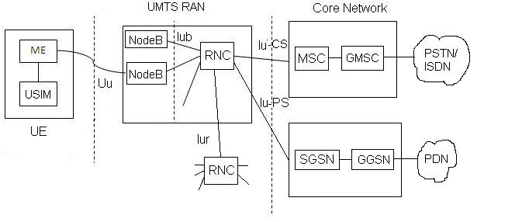
UMTS Network Architecture
The UMTS network architecture is divided into three main elements
User Equipment (UE),
Radio Network Subsystem(RAN)
Core Network

Slide 45
User Equipment (UE)
UE incorporates greater functionality
compared to a cell phone.
It can be thought of as both a mobile phone used for talking and a data terminal attached to a computer with no voce capability.
Radio Network Subsystem(RAN)
The RNS is the equivalent of BSS in GSM.
It provides and mages the wireless interface for the overall network.
Core Network
The Core network is the equivalent of the GSM Network Switching Subsystem(NSS)

